Slide 1
Workbook Working Capital
Internal Use Only
April 2017
EXCEL FILE:

Slide 2
Disclaimer
The content of this workbook has been produced by KPMG Germany/Deal Advisory on the basis of German accounting standards and/or IFRS, as well as considering KPMG Germany’s firm and country requirements, regulations, processes, policies and best practices. Please check your local accounting and other requirements before applying the content.

Slide 3
Overview (1/2) – Mission statement
Working Capital
Mission Statement:
Transparency about the company’s capital requirements (historical, current and future) resulting from the working capital items
Customer situation
Definition/Methodology/Tools of the basis analysis
Buy Side/Sell Side/JV
Determination of the cash flow and net debt effects (VAL)
Interpretation of purchase price mechanisms (M&A, TS)
Determination of a normal level of working capital (TS)
Turnaround/Rapid Transformation
Identification of liquidity potentials (RES)
 |  | Preliminary definition
WC - Positions |  | narrow | broad
Assets
Trade receivables | (+) | ✓ | ✓
Inventory | (+) | ✓ | ✓
Advance payments | (+) |  | ✓
Other receivables | (+) |  | ✓
Deferred tax assets | (+) |  | ✓
Prepaid expenses | (+) |  | ✓
Liabilities
Trade payables | (-) | ✓ | ✓
Advance received | (-) | ✓ | ✓
Other current liabilities | (-) |  | ✓
(Current) provisions | (-) |  | ✓
Deferred tax liabilities | (-) |  | ✓
Deferred income | (-) |  | ✓
Note: A documentation of the items includes in the WC is absolutely necessary
Distinction between narrow and broad definition
In the narrow definition the items included in the normal case are covered.
In the broad definition additional non-interest-bearing items may be included in the WC definition so as to be able to cover sector or target specific aspects, e.g.:
Advance payments received in construction business
Other requirements in the framework of purchase price negotiations
Inclusion of factored trade receivables may be necessary to present the real total WC financing needs of the target
Degree of standardization
Documented allocation of all balance sheet items in the framework of the definition of the working capital
Consideration of the sector and customer situation required
Workbook example
Please be aware that this workbook is built up on different examples from various reports, e.g.:
XYZ company ABC group (machinery industry) Peer group comparison

Slide 4
Overview (2/2) – Core issues
Working Capital
Core Issue
Specific analysis
Alternatives
Page(s)
1.
5-7
Basics: What is the reason and approach for a WC analysis?
2.
How did the working capital develop in the past?
Analysis and presentation of the past development of the working capital by item
Analysis and presentation of days outstanding for receivables and payables, days inventory held and cash conversion cycle
Alternative 1 – narrow def.
8
8-10
Alternative 2 – narrow def.
9
Alternative 3 – broad def.
10
3.
Does seasonality influence the development of working capital?
Analysis, to what extent stocks, receivables and payables are influenced by seasonality
Alternative 1
11
11-12
Alternative 2
12
4.
What is the company’s performance relative to its peers?
Analysis and presentation of benchmarks for WC KPIs
13-15
5.
What are the drivers of stocks, receivables and payables?
Outline of the individual drivers of WC KPIs
16-18
6.
What optimization measures have been identified and planned?
Analysis and presentation of WC optimization measures
Alternative 1
25
19-27
Alternative 2
26-27
7.
How much capital is the working capital tying up at the moment and how much will it tie up in the future?
Analysis and presentation of the past and planned WC development on monthly basis.
Comparison of past and planned WC-KPIs as a plausibility test for working capital planning.
For transaction purposes define planned Working Capital analogue to Net Debt as the price will typically be adjusted for differences between Plan and Actual at closing date
28
8.
29
How is the financing of the working capital planned?
Analysis and presentation of the durations of stocks, receivables and payables cycles as well as their financing.

Slide 5
1. Basics: What is the reason and approach for a WC analysis?
Working Capital
Key question:
Why to outline Working Capital? - What is Working Capital? - How to analyze Working Capital?
?
?
?
Representation of Trade Working Capital, composition, seasonality and turnover time (maturities)
Working Capital:
Receivables
Inventories
Payables
Additional items depending on industry and depth of analysis, e.g. operating cash on hand; payments received
Identify needs for further action
What?
How?
Impact on Liquidity
Demonstrates important aspects of capital requirements
Comparison of turnover times with competition and experience
Analysis provides important indicators and plausibility points for the planning
Statements concerning the relationship between:
DSO
DPO
DIH
CCC
Additional items depending on industry and depth of analysis or payments received
Why?
Working capital
vs.
Net working capital
WC = current assets - short-term liabilities
NWC = current assets - short-term liabilities - liquid funds

Slide 6
1. Basics: What is the reason and approach for a WC analysis?
Working Capital
Example
Without taking into account the advance payments received, the average cash conversion cycle is currently at approx. 197 days due to the high inventory reach.
Taking into account the advance payments received, the resulting average cash conversion cycle amounts to approx. 73 days.
Working Capital Cycle (schematic)
Accounts payable management
Inventory management
Account receivable management
Purchase commitments
Accounts
payable
Raw materials
and supplies
Work in
progress
Finished
products
Accounts receivable
Inventory turnover
Collection period
Schematic illustration
Buffer stock
Production
Finished products inventory
Term of payment
Cash conversion
Financing gap without advance payments
DIH: 204 days
DPO: 73 days
DSO: 66 days
CCC: 197 days
Financing gap incl. advance payments
DIH: 204 days
DPO: 197 days
DSO: 66 days
CCC: 73 days
Purchasing
Outgoing payment
Start of
production
End of
production
Sales
Incoming payment
Use this overview to show CCC as the financing gap / requirement of the company.

Slide 7
1. Basics: What is the reason and approach for a WC analysis?
Working Capital
Days sales outstanding
Days inventory held
Days payable outstanding
Cash Conversion Cycle
1.
Alternative – Evaluation of WC with material cost and COGS depending on availability of data
DSO
=
Ø Trade receivables
x 365 days
DIH
Ø Inventory
x 365 days
DPO
Ø Trade payables
x 365 days
=
=
Sales revenues per day
Material cost or
COGS per day
Material cost or COGS per day
2.
Alternative – Evaluation of WC with sales
DSO
=
Ø Trade receivables
x 365 days
DIH
Ø Inventory
x 365 days
DPO
Ø Trade payables
x 365 days
=
=
Material cost
Sales revenues per day
Sales
DSO
+
DIH
-
DPO
=
CCC
Year-end values are calculated on 365 days basis. Monthly values based on actual days in month (31,30, 28 for Feb).
Quarterly values respectively. For monthly and quarterly KPIs, average numerator values are to be used.

Slide 8
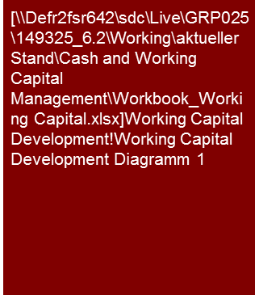

2. How did the working capital develop in the past?
Working Capital
Alternative 1 (narrow definition)
Example
The working capital increased by €4 million to €24 million from 2012 to 2015
The term of the working capital (CCC) has increased in the comparative period by eight days to 56 days in 2015
The material driver is the increase in receivables from €21m (2012) to €23m (2015).
Net Working Capital development (in €m) 2012 - 2015
Working capital development
The balance sheet in the period under observation 2012 (€20 million) to 2015 (€24 million) showed slightly increasing average amounts of WC. In comparison to the lowest average value in the observation period, €19 million in 2013, the WC of €24 million in 2015 was about €5 million higher
The increase in WC by €4 million from 2012 to 2015 resulted primarily from increased receivables (€2 million in 2014) and increased stocks in 2014 and 2015 (€1 million and €2 million respectively)
The cash conversion cycle (CCC) increased in the period of 2012 to 2015 by 8 days – to 56 days in 2015. This resulted from the following developments:
Trade receivables
The trade receivables increased by 6 days from 37 days in 2012 to 43 days in 2015 (+16.2%)
The external sales declined in the period 2012 (€ […] million) to 2015 (€[…] million) (CAGR: […]%)
Inventory
Inventory increased in the period under observation by 2 days (+5%) from 40 days to 42 days
Trade payables
The term of trade payables in 2012 and 2015 was 29 days; this was, however, subject to slight fluctuations in the period under observation
Working capital development
+€4m
NWC: €24m
Working capital items
Terms of Working Capital (CCC) (in days) 2012 - 2015
+8d
Compulsory content:
Development by WC item
Development of WC KPIs (DSO, DPO, DIH, CCC)
This is a sample commentary text.
Adapt as applicable.
Tools
Excel Analysis
Source: Company information, KPMG analysis.

Slide 9
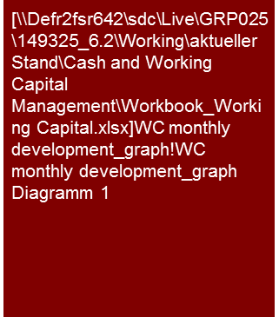
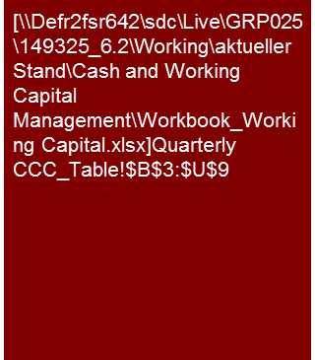
2. How did the working capital develop in the past?
Working Capital
Alternative 2 (narrow definition)
Example
The net working capital exhibits considerable fluctuations in the monthly development. These result in particular from the reduction of inventories for the summer and Christmas business.
The absolute capital commitment in YTD 2015 averaged €[…] million
The ABC group was able to improve its relative capital commitment in working capital (cash conversion) especially with the reduction of inventories of old goods.
Net working capital – monthly development (in €000) 2008 - YTD 2012
2011
2012
2013
2014
YTD2015
Note: Due to the fact that inventory changes are not recorded in the general ledger on a monthly basis, we have based our monthly analyses on storage lists for finished and unfinished goods. Information on the monthly movements of raw materials were not available to us.
Source: Company information, KPMG analysis
The strong decline of the net working capital was in particular attributable to the consequences of the global economic crisis, which had a negative impact on customer orders and sales.
The strong increase of the working capital days in 1Q results from a lower sales and COGS in 4Q 2011 and 1Q 2012 in 2Q a high overdue trade liability has been paid, resulting in a decline of trade payables
Inventories generally climb during the first half of the year, and during the months September to November so as to satisfy the summer and Christmas demand
The decline in the working capital days primarily reflects the recovery of the global automobile industry (higher sales better payment terms)
Compulsory content:
Development by WC item
Development of WC KPIs (DSO, DPO, DIH, CCC)
This is a sample commentary text.
Adapt as applicable.
Tools
Excel Analysis
Source: Company information, KPMG analysis.

Slide 10
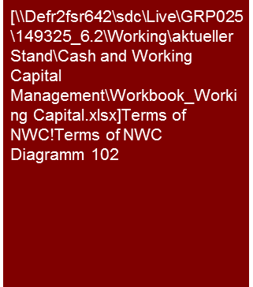

2. How did the working capital develop in the past?
Working Capital
Alternative 3 (broad definition, detailed presentation)
Example
Due to the consistent increase in DPO, the working capital was reduced by September 2015.
The slight increase in October is the result of the increase in inventories, which in turn is particularly attributable to the pre-processing of customer orders.
The coverage rate remained almost constant at 60%. Thus, working capital has been significantly reduced.
ABC group - Terms of Net Working Capital (in days) Feb - Oct 2015
ABC group – CCC development (in days) Feb - Oct 2014
Coverage rate:
62%
61%
63%
64%
61%
59%
58%
56%
57%
60%
197
Use this detailed page whenever customer advanced payments or factoring have major influence on working capital requirements (e.g. construction industry).
Working Capital reduction due to customer advance payment
124
73
Tools
Excel Analysis
Average Feb-Oct 15
CAP = customer advance payments Coverage rate = NWC requirement covered by CAP
Source: Company information, KPMG analysis.

Slide 11
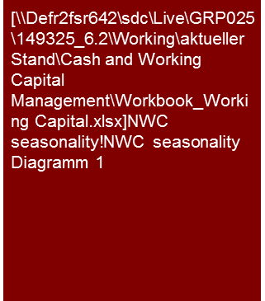
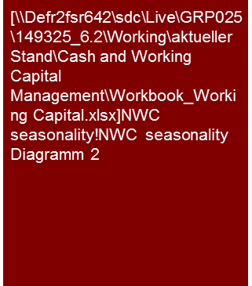

3. Does seasonality influence the development of working capital?
Working Capital
Alternative 1
Example
The levels of working capital indicate significant seasonality.
The fluctuation of the cash conversion cycle results from sales seasonality paired with insufficient inventory management.
Analogue to the observation of the annual values, the monthly development also indicates a trend.
Net working capital – monthly development (in €m)
Cash Conversion Cycle – monthly development (in days) and sales (in €m)
10
12
12
10
12
12
11
13
13
10
12
12
Tools
Excel Analysis

Slide 12
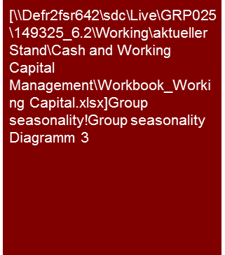
3. Does seasonality influence the development of working capital?
Working Capital
Alternative 2
Example
Throughout the financial year 2014/15 the net working capital needs fluctuated between €2.6 million and €3.1 million.
Seasonality results in financing need peaks of up to €0.3 million and reliefs of up to €0.4 million.
Further material effects result from the balance sheet policy induced peaks every six months.
Group seasonality 2014/2015
€m | Feb | Mar | Apr | May | Jun | Jul | Aug | Sep | Oct | Nov | Dec | Jan
Net working capital | 2.9 | 3.0 | 3.1 | 3.0 | 3.0 | 2.8 | 2.8 | 3.1 | 3.0 | 2.9 | 3.0 | 2.6
Inventory | 1.8 | 1.8 | 1.8 | 1.7 | 1.8 | 1.9 | 1.8 | 1.8 | 1.9 | 1.9 | 1.9 | 1.6
Receivables | 3.4 | 3.3 | 3.5 | 3.5 | 3.4 | 3.5 | 3.3 | 3.4 | 3.6 | 3.6 | 3.5 | 3.4
Payables | (2.3) | (2.1) | (2.2) | (2.3) | (2.3) | (2.6) | (2.2) | (2.1) | (2.5) | (2.5) | (2.4) | (2.4)
Change in NWC
€m
1
4
2
3
5
Commentary example
Reduction of inventories (in the amount of €0.2 million) in February after reduction of the balance sheet optimization at the end of the previous year. Reduction of above-average high payables -€0.1 million due to payment delays for the reporting date.
As a consequence of weak sales, the trade payables drop in March by an additional €0.1 million to the lowest level of the year.
In July there was another short-term extension of the payment target with suppliers (trade payables +€0.2 million) in order to fulfil the covenant requirements.
Commentary example (continued)
The financing peak in September results primarily from higher trade receivables resulting from higher sales following a weak summer business.
At the end of the financial year a new working capital optimization took place. To that end inventories and receivables were reduced by €0.4 million, respectively.
1
4
5
2
Tools
Excel Analysis
3

Slide 13
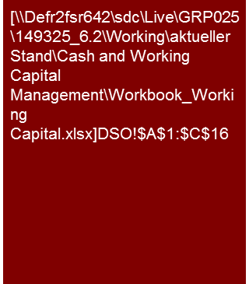
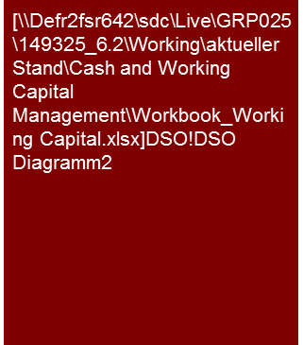
4. What is the company’s performance relatively to its peers? Focus on [DSO]
Working Capital
Average peers
Average competitors
Benchmark
Example
1)
In the direct competitor comparison, in particular Peer 2, Peer 3, Peer 8, Peer 13, Peer 10 and Peer 11 have a potential in reducing DSO.
Taking the mean value of all individual competitors into account as well as the weighted mean of all peers under review, DSO holds an improvement potential of 2 days.
Average values February 2014 to October 2014
Average values of the individual direct competitors 2012 to 2013, if available
+
-
-
+
+
+
+
-
+
-
-
+
2)
3)
-
-
∆ (2) days = weighted mean Ø 65
Note: 1) Trade receivables * 365 / Turnover
2) Weighted mean (basis: Turnover Jan to Oct 2014 of all 13 operative XYZ companies)
3) Mean values of all competitors, adjusted by the highest and lowest value
Source: Company information, Amadeus, KPMG analysis
Compulsory content:
DSO target
DSO peers
This is a sample commentary text.
Adapt as applicable.
Within the peer group, there are considerable fluctuations concerning DSO, above all attributable to the peers Peer 11 and Peer 10. Peer 9 has the best DSO by far, together with Peer 12 and Peer 6. The weighted mean of all peers is at approx. 66 days.
In the direct competitor comparison, all XYZ companies other than Peer 12, Peer 5, Peer 6, Peer 9, Peer 7, Peer 4 and Peer 1 have higher DSO. The negative deviations are generally moderate. Here again, the Peer 10 and Peer 11 well as Peer 2, Peer 3, Peer 8 and Peer 13 are the exceptions, having the highest optimization potentials in accordance with external benchmarking.
Tools
Excel Analysis

Slide 14
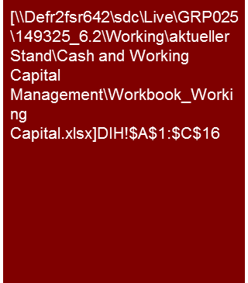
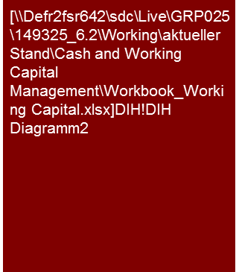
4. What is the company’s performance relatively to its peers? Focus on [DIH]
Working Capital
Average peers
Average competitors
Benchmark
Example
1)
All companies other than Peer 4 have potentials in reducing DIH.
Taking into account the mean value of all individual competitors as well as the weighted mean of all group companies under review, DIH holds an improvement potential of 22 days in the medium term.
Average values February 2014 to October 2014
Average values of the individual direct competitors 2012 to 2013, if available
-
-
n/a
+
-
n/a
n/a
-
-
-
-
-
2)
3)
-
-
∆ (22) days
Note: 1) Trade receivables * 365 / Material costs
2) Weighted mean (basis: Turnover Jan to Oct 2014 of all 13 operative XYZ companies)
3) Mean values of all competitors, adjusted by the highest and lowest value as well as without Spanish and Italian competitors (Peer 14, Peer 15, Peer 16, Peer 17)
Source: Company information, Amadeus, KPMG analysis
Compulsory content:
DIH target
DIH peers
This is a sample commentary text.
Adapt as applicable.
There are considerable fluctuations in DIH within the individual subsidiaries. Peer 5 and Peer 9 are the companies with the highest DIH (> 300 days). Peer 12 and Peer 11 on the other hand have a low DIH. The weighted mean of all core companies is at approx. 204 days.
In the direct competitor comparison, only Peer 4 with an average of 170 days has better DIH than its benchmark (198 days; benchmark Peer 4). All other subsidiaries show significant deviations and a corresponding optimization potential.
Tools
Excel Analysis

Slide 15
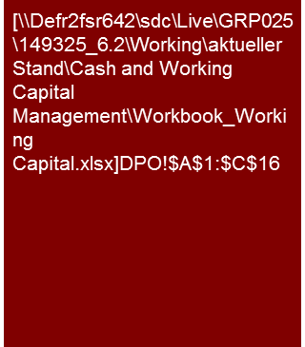

4. What is the company’s performance relatively to its peers? Focus on [DPO]
Working Capital
Average peers
Average competitors
Benchmark
Example
1)
In the direct competitor comparison, above all Peer 5, Peer 4 and Peer 13 have possible improvement potential in DPO.
Taking into account the mean value of all individual competitors as well as the weighted mean of all group companies under review, DIH holds an improvement potential of 2 days.
Average values February 2014 to October 2014
Average values of the individual direct competitors 2012 to 2013, if available
+
+
n/a
-
-
n/a
n/a
+
n/a
+
+
+
2)
3)
-
-
Compulsory content:
DPO target
DPO peers
This is a sample commentary text.
Adapt as applicable.
Notice: Benchmarking results should be analyzed carefully whenever companies with total cost accounting are compared to companies with cost of sales accounting as COGS include more than material cost only
∆ (2) days
Note: 1) Trade receivables * 365 / Material costs
2) Weighted mean (basis: Turnover Jan to Oct 2014 of all 13 operative XYZ companies)
3) Mean values of all competitors, adjusted by the highest and lowest value as well as without Spanish and Italian competitors (Peer 14, Peer 15, Peer 16, Peer 17)
Source: Company information, Amadeus, KPMG analysis
There are considerable fluctuations within the individual peers. Above all, foreign companies (Peer 2, Peer 10 and Peer 11) are companies with high DPO due to their payment history. The weighted mean of all core companies is at approx. 73 days.
In the direct competitor comparison, many XYZ companies have longer DSO than their respective peer group. The reasons thereof can be found in the sustainable re-negotiations of existing supplier contracts as well as the establishment of a central cash pool within the holding company. Above all, Peer 13, Peer 4 and Peer 5 have potentials.
Tools
Excel Analysis

Slide 16
5. What are the drivers of the receivables? Focus on [DSO]
Working Capital
Example
Commentary
Major drivers are order lead times, effective time of invoicing, payment patterns of the customers as well as debtor management process.
Due to the long order lead times and significant time lag between invoicing and delivery, 44% of receivables are overdue.
Maturity structure of trade receivables (in €m) as of Oct 2015
This high DSO mostly results from the time of invoicing in combination with the long time to initial operation at the customer's (order lead time up to […] months, […] of which between invoice and initial operation at the customer's).
The accounts receivable due are very high at 44% in comparison with the total trade accounts receivable. Thereof, approx. 26% have been due for at least 60 days.
The reasons thereof are above all the above-stated long time between invoicing and initial operation as well as lack of a deadline clause for the transfer of the last partial sums in the contract as well as accounts receivable management needing improvement
Inclusion of deadline clauses in customer contracts as well as use of design review for a second advance payment have been identified as further measures improving the DPO.
Payment patterns / conditions
Dunning
Means of payment
Time of invoicing
Order lead time
Debtor management process
26%
100%
56%
15%
11%
18%
Overdue
= 44%
overdue
Typical payment pattern (example: ABC group)
Status-quo
Target structure
Advance payment
30%
30%
20%
Advance payment received
2. Advance payment in case of design review
Time of invoicing
What are possible drivers?
FAT (machine leaves premises)
30-50%
30%
Compulsory content:
Maturity structure of trade receivables
Typical payment pattern
This is a sample commentary text.
Adapt as applicable.
Up to 4 months
After initial operation at the customer’s
10-30%
10%
Amount of invoice
SAT (after production run at the customer’s)
10%
Up to 6 months
10%
Source: Company information

Slide 17
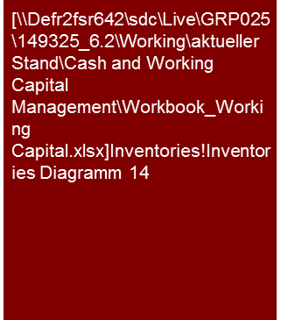
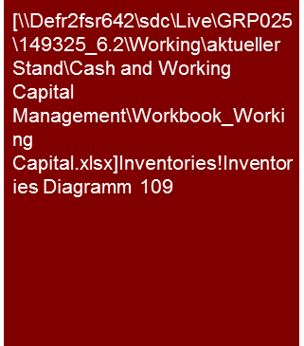
5. What are the drivers of the inventory? Focus on [DIH]
Working Capital
Example
Commentary
Potentials can be found in the reduction of raw materials and supply as well as in work in progress.
A detailed analysis of raw materials and supplies as well as of work in progress is recommended.
Inventory structure (in €m) as of October 2008
Inventory build-up in the second half of the year has reached its peak in August, major driver being work in progress. As numerous deliveries are planned till the end of the year this value shall go down by year-end.
Further optimization of work in progress can be achieved by standardization of construction process and machines, reduction in standing times of work in progress which may be a result of delayed machine deliveries (in case of complete solutions) and improvement of project management.
The share of raw materials and supplies in total inventory is 29%. The above measures as well as better coordination of procurement and production planning may be used to optimize this value.
Production lead time
Logistics lead time
Warehousing
Standardization
Range of goods
Supply chain management
Product diversity
Inventories €8.4 m
Note: According to the information received, there are no finished goods
Development inventories in €m (Jan – Oct 2008)
What are possible drivers?
+ €0.1m
Compulsory content:
Inventory structure at latest date
Inventory structure development on monthly basis (seasonality)
Aging of finished goods if their share in total inventory is high
This is a sample commentary text.
Adapt as applicable.
Tools
Excel Analysis
Source: Company information, KPMG analysis.
Rmat. = Raw material; WIP = Work in progress; CAP = Customer advanced payments

Slide 18
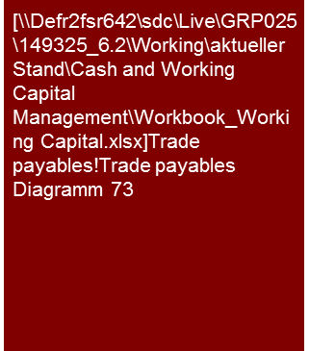
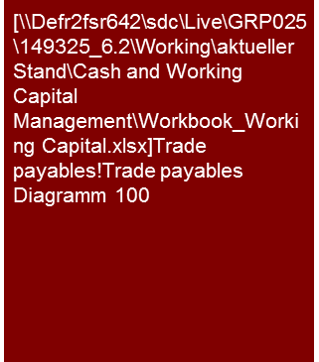
5. What are the drivers of the payables? Focus on [DPO]
Working Capital
Example
Commentary
Due to the measures implemented by the holding company average DPO as of October 2015 has risen by €2.3 million. The purchasing volume of standardized products by conditions of payments is on average €14.7 million.
Trade payables development (in €m), incl. IC (Inter Company) trade payables 2015
Since July 2015, the development of the accounts payable shows a considerable increase, which is above all attributable to the sustainable re-negotiation of existing supplier contracts as well as the establishment of a central cash pool in the holding company.
The purchasing volume (January to November 2015) was at approx. €14.7 million and is attributable to 541 suppliers.
In the period under review 1. Dec. 2014 – 30. Nov. 2015, purchases amounted to approx. €8.1million (55%) of the total volume with a term of payment of 30 days net, €4 million (27%) with a term of payment of 60 days net and €0.5 million (3%) with a term of payment of 90 days net.
In accordance with the information received from management, the re-negotiation of the terms of payment to 90 days net is being pursued.
Currently, the cash discount rate of 3% agreed upon with suppliers is used only in exceptional cases. This is completely at the expense of the operative margin and of liquidity.
Payment conditions
Payment processes
Optimization of cashback
∆ €2.3m
Purchasing volume of standardized products by conditions of payment (in €m) 1. Dec. 2014 – 30. Nov. 2015
Compulsory content:
Trade payables structure development on monthly basis (seasonality)
Purchasing volume by terms of payment
Optional: ABC-supplier or material analysis by terms of payment
This is a sample commentary text.
Adapt as applicable.
€14.7 m
Terms of payment are the last possible date of payment in accordance with the agreement (net term of payment)
Comments
Tools
Excel Analysis
Source: Company information, KPMG analysis.

Slide 19
6. What optimization measures have been identified and planned? [Overview and systematics of cash generating measures]
Working Capital
Example measures
Strategic
Adjust cash processes
Structural
Change business model
High risk
Less capital intensive production and logistics channels
Debt restructuring
Redefine supply chain
Cost cutting (operational & G&A)
Divest cash burning business units
Terms & Conditions (esp. cash discounts)
Optimize Order-to-cash
Decrease DSO
Tactic
Optimize Forecast-to-fulfil
Incentivize cash management
Get pensions off-balance
Adjust product portfolio (incl. design & production)
Pre-payments
Optimize location portfolio
Investments
Payroll tax
Direct & indirect tax
Introduce cash KPI for procurement, production & sales
Get pensions off-balance
Reduce collection period
Reduce inventory
Tactical Cash Management → Working Capital
Manage working capital throughout the supply chain
Strategic Cash & Working Capital Management
Operational
Operational Cash Management
Increase DPO
Optimize Purchase-to-pay
Stakeholder management and communication inclusive cash performance
Overdue debt collection
Low risk
Reduce purchase
Cash Pooling & Cash Flow Forecasting
Divest non-core assets
Cash in control
Short term
Mid term
Long term

Slide 20
6. What optimization measures have been identified and planned? (Influences of short-term measures)
Working Capital
Sales Outstanding
Inventory Turnover
Payables Outstanding
Enforce escalation in case of delayed payments
Agree on terms for installations and partial payments
Employ factoring service companies
Accelerate customer complaint processes
Obtain credit default insurance
Make use of asset backed securitization
Provide receivables information to the sales department
…
Sell-off slow sellers and remainder of stocks
Reduce the safety stock level
Optimization of batch sizes
Implement just-in-time production
Reduce vertical range of manufacturing
Improve stock accounting
Hedge currency risk for foreign transactions
Standardize and modulate products and components
Change disposition process / cycles
Reduce inventory range
Shorten processing time
Enhance planning system and accuracy
…
Selectively renegotiate payment terms and conditions
Introduce cash desk
Set-up cash pooling
Optimize complaint processes
Renegotiate reimbursements and the usage of bonuses
Optimize material requirements planning
Optimize usage of early payment discounts and net payments
…
Establish a cash culture to sustainably free up liquidity without jeopardizing the performance or delivery capacity and maintain the level of credit worthiness.

Slide 21
6. What optimization measures have been identified and planned? [Overview operational processes]
Working Capital
Order-to-Cash
DSO
Demand forecast & Sales
Credit risk management
Invoicing/ Billing
Dispute
Management
Collections
Cash
allocation
Master data
Usually focused on
Forecast-to-Fulfill
DIH
Product Range
Management
Production and sales planning
Purchasing & replenishment planning
Manufacturing
Scheduling &
Execution
Stock-keeping and distribution
Delivery
Supply Chain Management
Usually focused on
Purchase-to-Pay
DPO
Demand forecast & Procurement planning
Supplier management
Procurement
Goods receipt
service
Invoice receipt & processing
Payment processing
Master data
Discrepancy Management
Usually focused on

Slide 22
6. What optimization measures have been identified and planned? [Order-to-cash]
Working Capital
Order-to-Cash – Typical problems are the best starting points for measures development
Demand
Forecast &
Sales
Credit risk
management
Invoicing/
Billing
Complaint
management
Collection
Cash
allocation
Master
data
Low forecast quality
No credit rating for potential customers
Long billing process (>3 days)
High complaint volume caused by internal mistakes
High overdue volume
Manual clearing process
Payment terms granted are not used
Payment targets have low priority during sales negotiations
Lacking communication of credit limits of customers to sales dep.
High spread of payment terms
Longsome clarification and crediting process
Dunning run every two weeks only
Closed receivables without clearing date
No real-time adjustment of renegotiated payment terms
No incentives for negotiating lower payment targets
Frequent overrun of credit limits
High volume of terms >30 days
Purely manual complaints management
Dunning process not standardized and not automated
Clearing check of discount volume not term
No systematic controls of data quality
High discounts paired with long discount payment targets
Rare use of trade credit insurer
Unfavorable combination of payment terms (targets + discount)
High volume on credit in process
Granting discounts even after expiration date
Erroneous parametrization of payment terms
Comprehensive WCM needs to encompass the whole process

Slide 23
6. What optimization measures have been identified and planned? [Forecast-to-fulfil]
Working Capital
Forecast-to-fulfil – Typical problems are the best starting points for measures development
Product
portfolio
Production
and sales
planning
Material
planning
Production
process
Stock-keeping
and
distribution
Delivery
Supply Chain
Management
Development of product portfolio w/o consideration of capital needs
Low interdependence between sales and production
High safety stock to guarantee (flexible) product availability
High amount of inventory in interim storage or between sites
High level of slow moving goods
Delivery time has higher priority than cost
No integration of (key) suppliers in own ERP
High variety of products and models
Products are manufactured in larger quantities for economy of scale
Low transparency on (preferred) suppliers and their terms
Manufacturing is measured on utilization of equipment
Low transparency on stock levels
No real-time
data flow to
billing and complaints management
No integration of own ERP with (key) customers ERP
Low standardization grade of parts and materials
Inflexible production planning (long forerun)
Procurement dep. targets discounts instead of payment terms
High rate of scrap and deficient goods – missing quality process in production
High cost of moving stock between production sites and warehouses
Logistics platform delays (part order
shipments)
Unreliable suppliers
Lacking coordination between production sites
Low cost sourcing instead of optimal sourcing
Long throughput times in production and to distribution
Lacking investment in automated warehousing
Line to gate delays, gate to
shipping delays, local/destination
customs delays
Lack of understanding of capabilities of suppliers and service partners
Comprehensive WCM needs to encompass the whole process

Slide 24
6. What optimization measures have been identified and planned? [Purchase-to-pay]
Working Capital
Purchase-to-Pay - Typical problems are the best starting points for measures development
Demand
forecast & Procurement
planning
Supplier
management
Procurement
Goods
receipt
service
Invoice receipt
& processing
Payment
processing
Master data
Purchasing volume is planned manually
No supplier categorization and consolidation
Decentral purchasing/ no clear competencies
Slow/ erroneous recording of goods receipt
Longsome invoice verification
Too high payment run frequency (daily)
No systematic controls of data quality
Order and batch sizes driven by discounts
High volume with payment terms <15 days
Many purchases w/o reference
Longsome clarification of discrepancies
Manual and paper based verification process
High amount of payments before due date
No systematic process to delete old data
No deviation and route-cause analysis
Low usage of vouchers and coupons
Missing frame agreements for critical materials/ goods
Decentral goods receipt service
Invoice data is the basis date for due date calculation
Suppliers with direct debit use it before agreed due dates
Erroneous parametrization of payment terms
Small volume with supplier discounts
No hedging of raw material risk
High rate of erroneous deliveries
Wrong payment conditions are recorded
No 4-eyes-controlls before payments are made
Master data recording and invoicing done by the same people
Comprehensive WCM needs to encompass the whole process

Slide 25
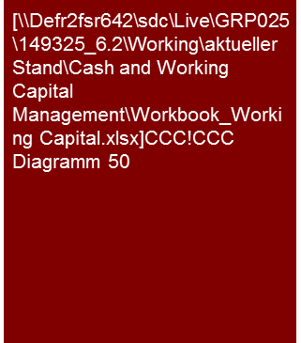

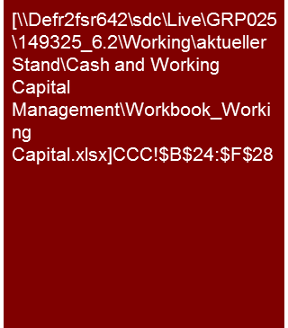
6. What optimization measures have been identified and planned?
Working Capital
Alternative 1
Example
Commentary
The cash conversion cycle declines to 171 days, which is based primarily on the reduction of the DIH from 204 days to 182 days.
Target deduction (in days) - CCC
The average Working Capital Days (CCC) of the 13 operating peer companies amount to 197 days and are therefore considerably above the comparative values of the internal (184 days) and external benchmarking (171 days).
This is above all due to lower DIH. The resulting optimization potential is 22 days. Experience shows that such reduction – due to its complexity - is only realizable in the medium term.
A DSO improvement is realizable in the short term. Taking into account the on-going supplier negotiations and the central cash pool already implemented, DPO improvement is also realizable in the short term.
This results in the following potentials
197
184
171
171
Possible potential allocation
Compulsory content:
Historical average NWC
External benchmark
Calculation of financial effects
Further content:
Internal benchmark (for group companies)
This is a sample commentary text.
Adapt as applicable.
(26) days
= 13%
Tools
Excel Analysis
Source: Company information, KPMG analysis

Slide 26
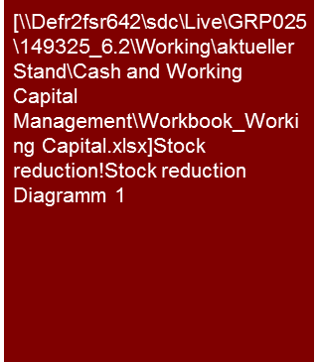
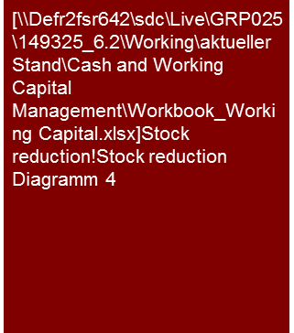
6. What optimization measures have been identified and planned? (1/2)
Working Capital
Alternative 2
Example
The target for the reduction of inventory is €300,000 by 31 October 2013 – about 1/3 thereof is already included in the budget planning of the ABC group.
This value is broken down by the individual sub-groups in accordance with the previously determined savings potential.
The restructuring case contains additional measures for the reduction of inventory by further €178,000.
Inventory development (in €000)
Stock reduction
€000 | Ø Stock Oct-Dec 15 | Stock reduction |  | Stock reduction budget | Stock reduction Res. Case
Germany |  | (94) | 18.3% | (49) | (45)
Italy |  | (45) | 16.1% | (7) | (38)
UK |  | (37) | 26.2% | (14) | (23)
Czech Republic |  | (26) | 25.0% | (10) | (16)
Denmark |  | (11) | 10.8% | (3) | (8)
France |  | (1) | 1.1% | (1) | (0)
Netherlands |  | (12) | 13.2% | (8) | (4)
Finland |  | (15) | 16.7% | (1) | (14)
Sweden |  | (1) | 1.4% | (1) | (0)
Norway |  | (15) | 21.1% | (3) | (12)
Switzerland |  | (11) | 18.3% | (3) | (8)
Hungary |  | (2) | 4.0% | (1) | (1)
Poland |  | (13) | 28.9% | (10) | (3)
Slovakia |  | (2) | 4.7% | (1) | (1)
Croatia |  | (4) | 17.4% | (2) | (2)
Austria |  | (1) | 4.5% | (1) | (0)
Bulgaria |  | (2) | 12.5% | (2) | (0)
Lithuania |  | (3) | 21.4% | (1) | (2)
Serbia |  | (2) | 15.4% | (2) | (0)
Estonia |  | (1) | 8.3% | (1) | (0)
Latvia |  | (2) | 18.2% | (1) | (1)
Group |  | (300) | 16.1% | (122) | (178)
Source: Company information, KPMG analysis
Commentary
The top down target for the reduction of the inventory by €300,000 by 31 October 2013 was approved bottom up with the involvement of the local management and their estimates.
Of the €300,000 , €122,000 are already contained in the budget. Important contributions are from Germany €49,000; UK €14,000 and the Czech Republic €10,000.
Additional measures for the reduction of the inventory by €178,000 are contained in the restructuring case.
Tools
Excel Analysis
Source: Company information, KPMG analysis

Slide 27
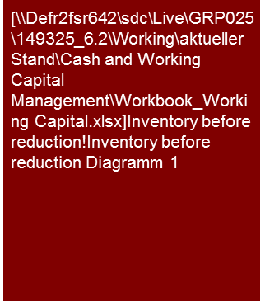
6. What optimization measures have been identified and planned? (2/2)
Working Capital
Alternative 2
Example
Inventory before reduction (in €m) Oct 2015 to Jan 2012
The “Initiative 2010” for the reduction of inventory distinguishes between immediate measures and structural measures.
The implementation of the immediate measures commences in March 2010. The structural measures have a mid-term focus and shall be implemented of June 2010.
The implementation of the measures must be executed at the sub-group level. A stringent controlling of the process and effects is absolutely essential.
Ø
€1.87m
€-300m -16.0%
€1.57m
€-1m -0.0%
€1.57m
Ø days
28.4 days
-17.9%
23.3 days
-3.1%
22.6 days
∅ Oct-Dec 15
Roadmap
Kick-off ABC 18 March to 20 March
Breakdown into various measures
Structural measures:
Rework warehousing concept (main warehouse/network warehouse)
Product adjustment of the marginal products
Adequate service level for the various segments
Selective organization of the product range per site/reduction of the goods sites
Immediate measures:
Adjustment of order parameters
Promotion programs
Steering of performance parameter
Product adjustment
Tools
Excel Analysis
Immediate measures
Structural measures
18.03
31.03
30.04
31.05
30.06
31.07
31.14
30.09
31.10
Source: Company information, KPMG analysis

Slide 28
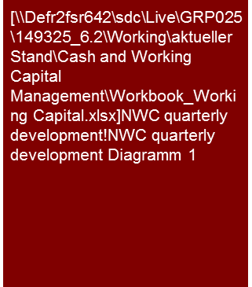
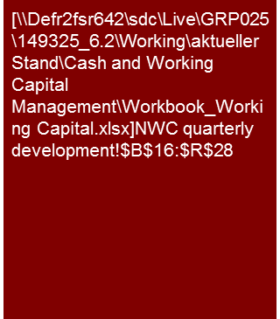
7. How much capital is the working capital tying up at the moment and how much will it tie up in the future? [Plausibility]
Working Capital
Example
The net working capital resulted in a relatively stable capital commitment in the period under observation (fluctuation of yearly average by +- € […]m).
The project business of ABC is strongly influenced by the client down payments which are projected to decrease in the future. As a countermeasure the company plans to decrease customer payment targets significantly.
Net working capital - quarterly development (in €m) Q1 2012 – Q4 2015
Working Capital
5.6
5.3
2.5
5.0
5.2
5.7
6.4
4.6
4.5
5.5
5.8
5.2
6.4
3.6
6.4
3.6
Actual
Plan
Source: KPMG analysis.
Commentary
The net working capital development depends on order intake, project mix and the payment conditions agreed upon.
The decline in cash conversion cycle is due to significantly lower prepayments, shorter payment targets by suppliers and higher inventory needed to cover higher planed sales.
As a result of the specific project business of ABC a bidder/buyer should have a sufficiently high net working capital headroom so as to be able to cover large fluctuations in the capital commitment as observed in the past.
Compulsory content:
Development by WC item
Development of WC KPIs (DSO, DPO, DIH, CCC)
This is a sample commentary text.
Adapt as applicable.
Tools
Excel Analysis
Note: DP = Down Payments
Source: KPMG analysis.

Slide 29
8. How is the financing of the working capital planned?
Working Capital
Example
Commentary
The material financial needs of the ABC group result from the capital bound in inventory and receivables. At group level this amounts to €5.2 billion and is covered to 39% by banks.
At the level of XYZ the percentage of bank financing for the total capital commitment is 50%. The main cause are short days sales outstanding that are insufficient to cover the working capital requirements.
Net working capital - quarterly development (in €m) Q1 2012 – Q4 2015
On group level the on-balance NWC amounts to €2.0 billion, corresponding to a cash conversion cycle of 31 days.
By adding the off-balance receivables the NWC increases to €2.9 billion (CCC of 45 days). In total €0.9 billion of receivables are off balance.
Inventory is solely financed by suppliers. Their payment terms furthermore cover €0.5 billion sales financing needs (20% on-balance receivables)
ABC group
€bn/(days)
Gross €5.2bn/( 81 days)
Net €2.9bn/(45 days)
Inventory
€1.8bn 28 days
Total receivables €3.5bn (53 days)
Off-balance
Trade payables
€2.3bn 36 days
Trade receivables
On-balance
€2.5bn
€0.9bn
€0.5bn = 20%
Sourcing
Sales
Cash out
Cash in
Financing
€2.3bn 44%
€2.0bn 39%
€0.9bn 17%
By supplier
By banks
By factor
The share of off-balance receivables (€353 million) of XYZ is higher than in the group.
Including the off-balance receivables NWC amounts €965 million (CCC of 52 days).
€265m of €474m of inventory held is financed by suppliers. The short DPO is insufficient to cover the financing need of stock held.
In total 50% of the working capital is financed by the banks.
YZX company
€m/(days)
Gross €1,230m/(67 days)
Net €965m/(52 days)
Commentary
Inventory
€474m 26 days
Total receivables €756m (41 days)
Compulsory content:
WC KPIs (DSO, DPO, DIH, CCC)
Off-balance financing sources such as factoring
On-balance financing sources such as banks or client advanced payments
This is a sample commentary text.
Adapt as applicable.
€265m 14 days
Trade payables
On-balance
€403m
€353m
Off-balance
Trade receivables
€209m
Sourcing
Cash out
Sales
Cash in
Tools
Excel Analysis
Financing
€265m 21%
€612m 50%
€353m 29%
By supplier
By banks
By factor

Slide 30
© 2017 KPMG International Cooperative (“KPMG International”). KPMG International provides no client services and is a Swiss entity with which the independent member firms of the KPMG network are affiliated.

